Slide 1
Practical Machine Learning

Slide 2
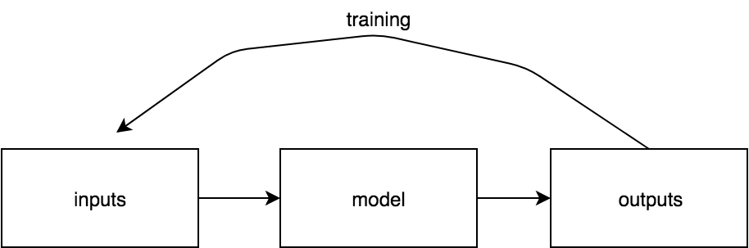
What is Machine Learning?

Slide 3
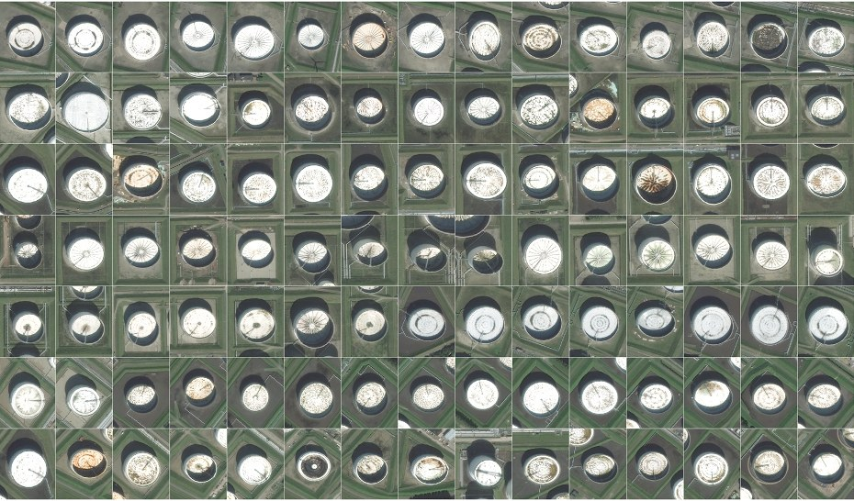

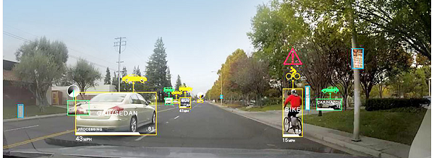
Why do we care?
wired.com
medicalfuturist.com
aitrends.com
Notes:
Useful for all sorts of things. Maybe not necessary to reinforce right now but will go over anyways
Patient medical records to help doctors diagnose and determine what exams to give patients
Radiology
Genomics
Self driving cars/object detection

Slide 4
Machine Learning Breakdown
Task framing
Data gathering/pre-processing
Model
Evaluation
Notes:
For me its helpful to breakdown the machine learning process into four parts …
Through the presentation I’ll step into each of these steps in more detail

Slide 5
Task Framing
What are you trying to accomplish?
What are the inputs? The outputs?
Special requirements?
Auditability?
Visualizations?

Slide 6
Demo - Task Framing
What are we trying to accomplish?
Predict and individuals ancestry
What are the inputs? The outputs?
Inputs: genetic variants (changes in DNA)
1000 Genomes Project
Outputs: ancestry classification, visualizations
But why?
Datasets with incomplete clinical data
Some diseases affect different populations at different rates

Slide 7
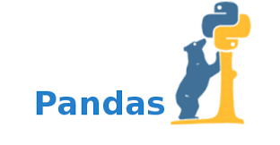



Live Demo Yikes
wikipedia.com
Notes:
Soooo I’m going to attempt to intersperce the presentation with a live demo, which I’m told is a bad idea because something always goes wrong, but we’re going to try it anyways.
I’m going to be using python today, and I’ll be leveraging three main libraries.
Jupyter notebook - You’ll see it in action in a moment, but its a way to run python code in chunks, and it comes along with some pretty niffty visualization capabilities. For those of you who know R it’s the same thing a R studio
Pandas - is a library thats really good for manipulating tabular data, which is how a large amount of machine learning data is represented
And SKlearn - A library that has handy wrappers for all sorts of machine learning models, helper functions, etc.

Slide 8
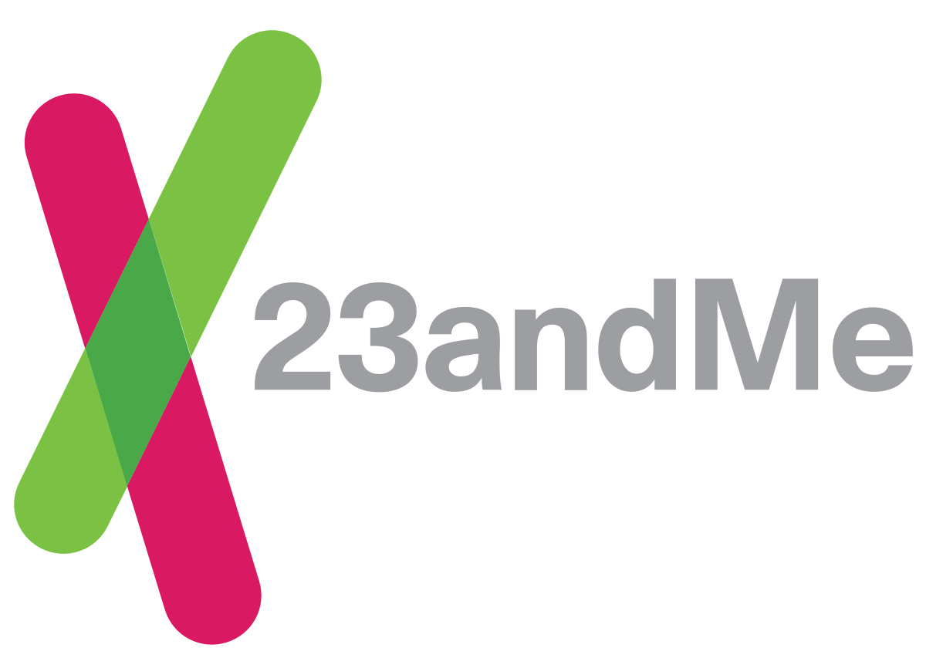
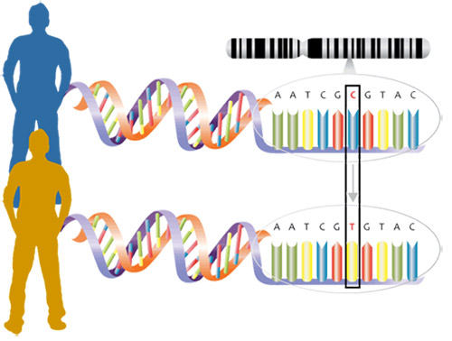
Demo - Ancestry Classifier
23andme.com
Ancestry prediction
African
European
East Asian
South Asian
North/South American
sciencebuddies.org
Notes:
IDK how many of you are familiar with 23and me, they take your dna sample and use it to tell you what your ancestry is. We’re going to essentially be building that.
We’ll start with genomic variants (which can be thought of as the little differences in the dna of a group of individuals) and use those variants to predict ancestry for an individual

Slide 9
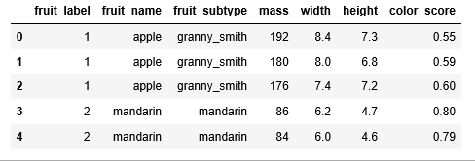
Data Data Data
What data do you need?
What data would you, as a human, need to solve this problem
features
samples
towardsdatascience.com
Notes:
A helpful way to think of what data you may need is to think about if a human would be able to pick out enough patterns in your dataset to solve whatever task you’re trying to accomplish. And if they can, you’re probably doing good.
Next question to ask yourself is is the data I want actually available, is it free, does it sit behind a paywall, what type of format is it in? Can I get it in the format needed?
And speaking of formats, there tends to be one most common type of format that pops up most often in machine learning and that’s tabular data
Which is what this dataset here is.

Slide 10
Dealing with data types: Categorical vs. Continuous
Continuous - a range of infinite possibilities
Categorical - discrete set of possibilities
towardsdatascience.com
Notes:
Continous variables, which is a variable that can take on an infinite range of possibilities.

Slide 11
Dealing with data types: Categorical vs. Continuous
Continuous - a range of infinite possibilities
Categorical - discrete set of possibilities
towardsdatascience.com
Notes:
Discrete set of possible values.
For in example in our dataset we could imagine there is some finite number of fruit names there could possibly be.

Slide 12
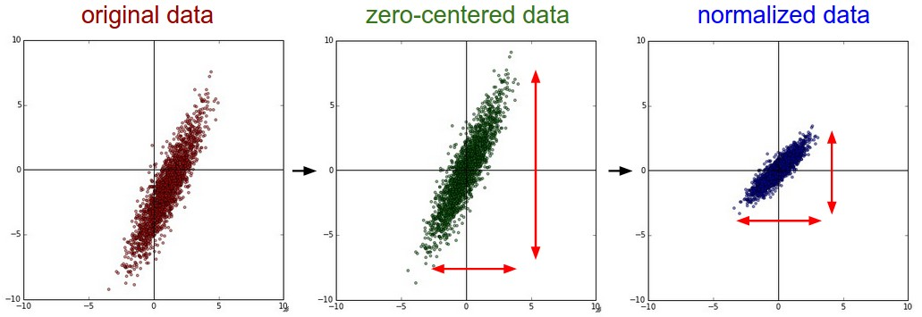
Dealing with data types: Continuous
http://cs231n.github.io/neural-networks-2/#datapre
Notes:
Many models have a requirement that inputs be normalized. In most cases this is chiefly to insure that all the features in your dataset are comparable to each other.
If your unsure, do it!

Slide 13
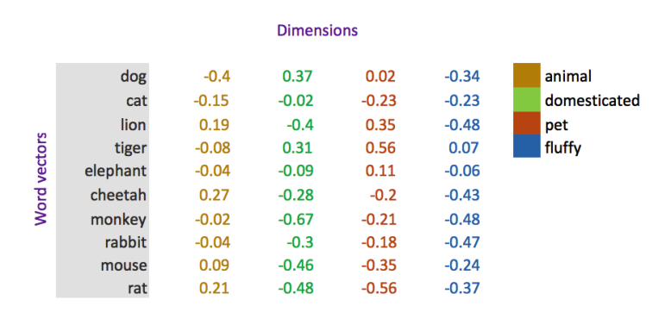
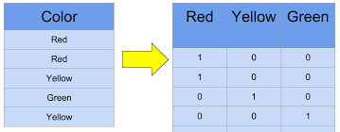
Dealing with data types: Categorical
Binned Height (Categorical) | Encoding
<65” | 0
65-70” | 1
70-75” | 2
>75” | 3
Encode as ordinals
Encode as vectors
kaggle.com
medium.com/@jayeshbahire
Notes:
Categorical variables you might have to think about a little more
Models work on numerical inputs, so we need to encode categorical variables numericaly. There are two main ways of doing this.
First you could encode as ordinals. You only really want to do this if your categorical variables have some intrinsic ordering to them. Like for example height …
But usually you dont want to encode variables that way. You want to use method number two, which is encoding them as vectors
There’s a number of different ways of doing this. The most straight forward is to use a method called one hot encoding. A one hot encoded vector is a vector whose length is the cardinality of whatever feature it is representing, where all values are 0 EXCEPT for the position cooresponding to what the feature value is (which is a one). Or put another way. Consists of separating all the different possiblities a categorical feature could be, and making an extra column for each one of those possibilities.

Slide 14
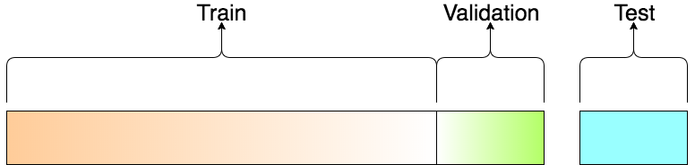
Training vs. Validation vs. Testing
Training data
Data used in model training
Validation data
Used for validation during training
Test data
Data meant to evaluate how well your model will generalize to data it has never seen
The model should never see this data during training
NEVER EVER. EVER EVER EVER.
towardsdatascience.com

Slide 15
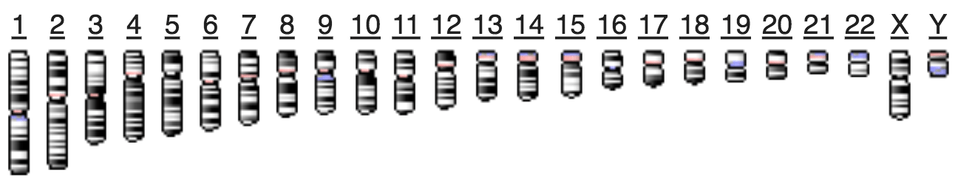
Our Example - Data
1,000 Genomes Project
Variant data for over 2,000 individuals
Variants are expressed as a genomic location and variant type
Variant Call Format (.vcf)
Represented as 0/0, 0/1, or 1/1
Individuals are classified as African, South Asian, East Asian, European, North/South American
gungorbudak.com
Notes:
Genomics crash course
Each of us in this room has DNA that repersents our genetic makeup
This genetic code existes as units called chromosomes, there are 22 of them plus and X and Y chromosome that are made up of nucleotide bases that can be one either an a t c or g. 3 billion plus bases in the genome
All of those chromosomes can be aligned to this thing called ther reference genome - which can be thought of as the quote unquote average human genome.
And since its only the average genome, we all in this room differ from that genome in different ways. Or in other words we all have different genetic variants
If we look at the picture down here ….
So how are these variants expressed in files?

Slide 16
Demo!

Slide 17
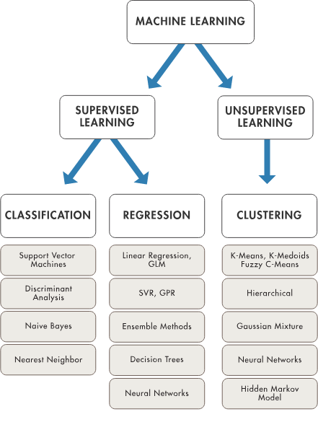
Models
Supervised vs Unsupervised
Dimensionality Reduction
mathworks.com

Slide 18
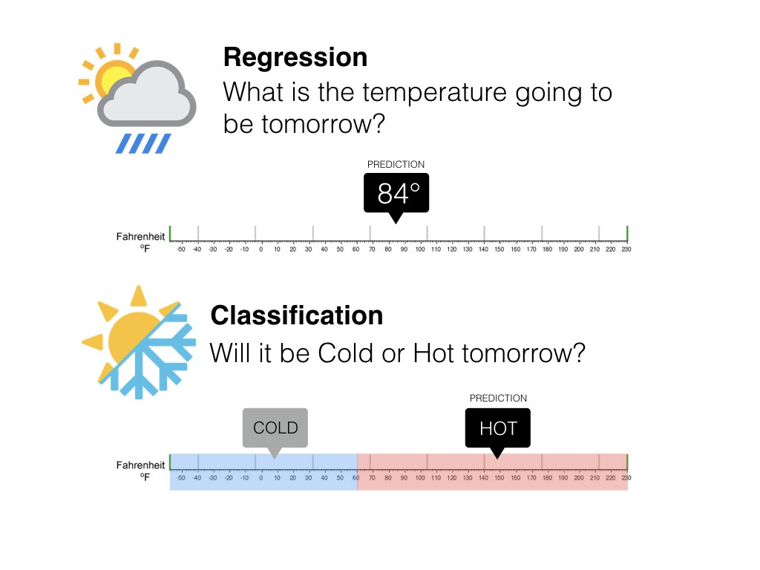
Supervised Learning
medium.com/@ali_88273

Slide 19
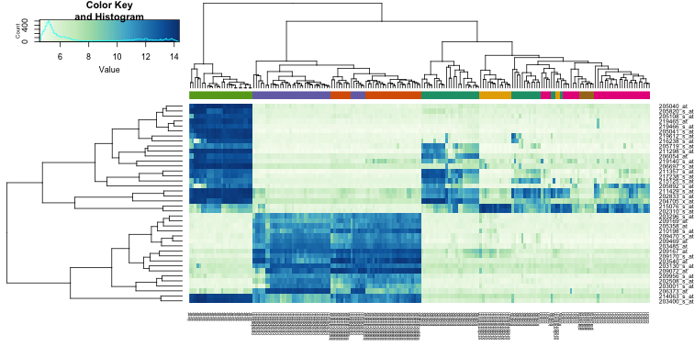
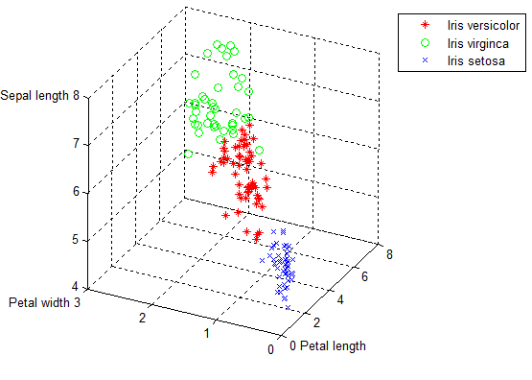
Unsupervised Learning
Clustering
genomicsclass.github.io
researchgate.net

Slide 20
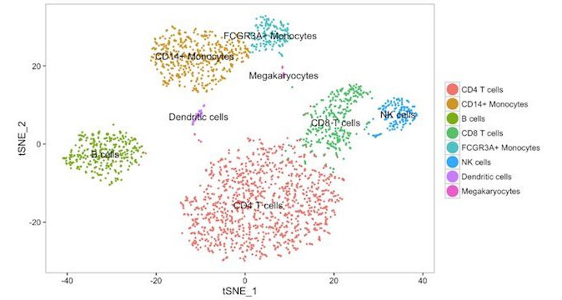
Unsupervised Learning
 | Movie 1 | Movie 2 | Movie 3 | Movie 4 | Movie 5 | Movie 6 | Movie 7 | …... | Movie 10,000
Person 1 | 0 | 0 | 1 | 5 | 2 | 1 | 0 |  | 3
…...
Person n | 4 | 3 | 1 | 2 | 5 | 1 | 5 |  | 4
Dimensionality Reduction
 | Component 1 (action-ness) | Component 2 (comedy-ness)
Person 1 | 0.55 | .98
…...
Person n | 1.12 | -0.34
Notes:
At its core dimensionality reduction is taking some dataset, and reducing it down to a smaller dataset, while preserving as much of the information in the original, larger dataset as possible

Slide 21

Demo - Models
medium.com/@williamkoehrsen

Slide 22


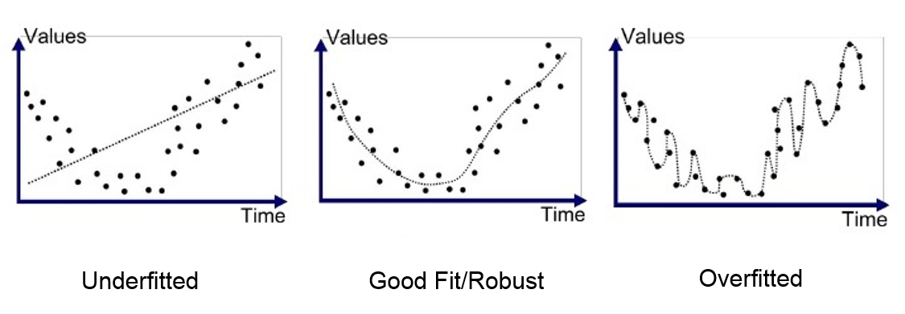
Evaluation
Training
Test
Training
Test
Training
Test

Slide 23
Demo!

Slide 24
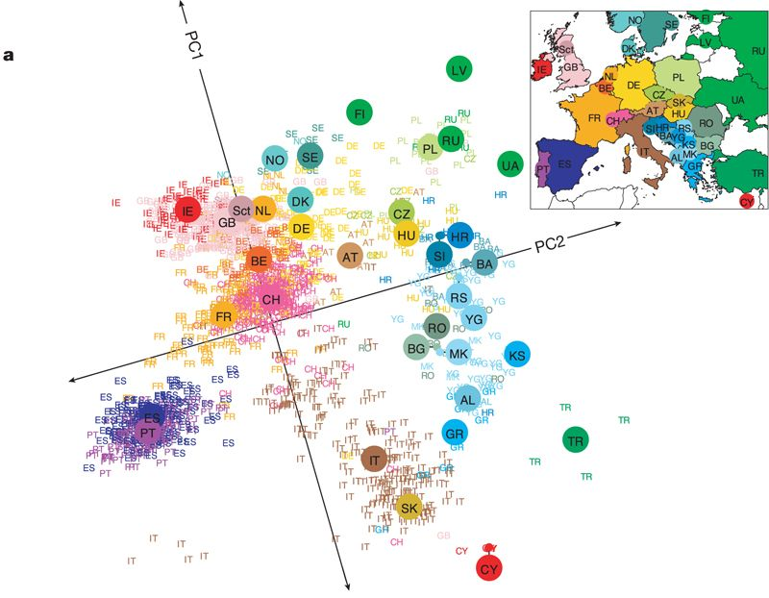
Novembre et. al.

Slide 25
Fun Links
Kaggle - kaggle.com
Fast.ai - fast.ai
80,000 Hours - https://80000hours.org/
Wait But Why: Picking a Career - https://waitbutwhy.com/2018/04/picking-career.html

